Slide 1
Why?
When your WHY is clear , Then your HOW is Easy.

Slide 2
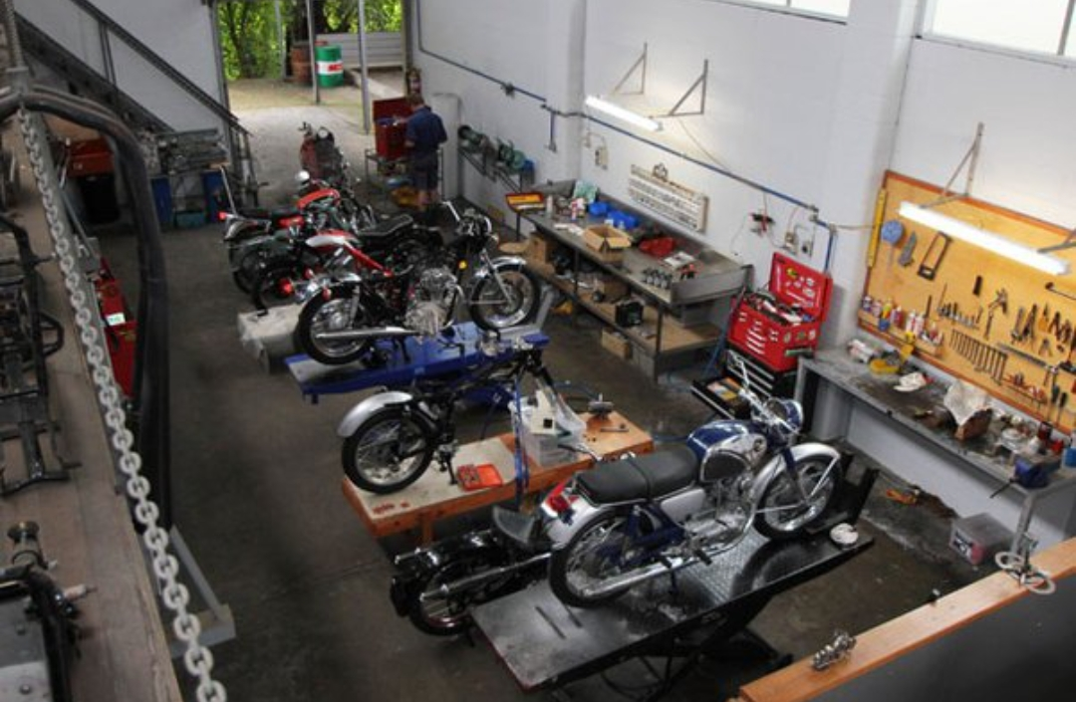
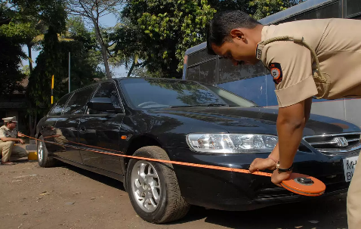
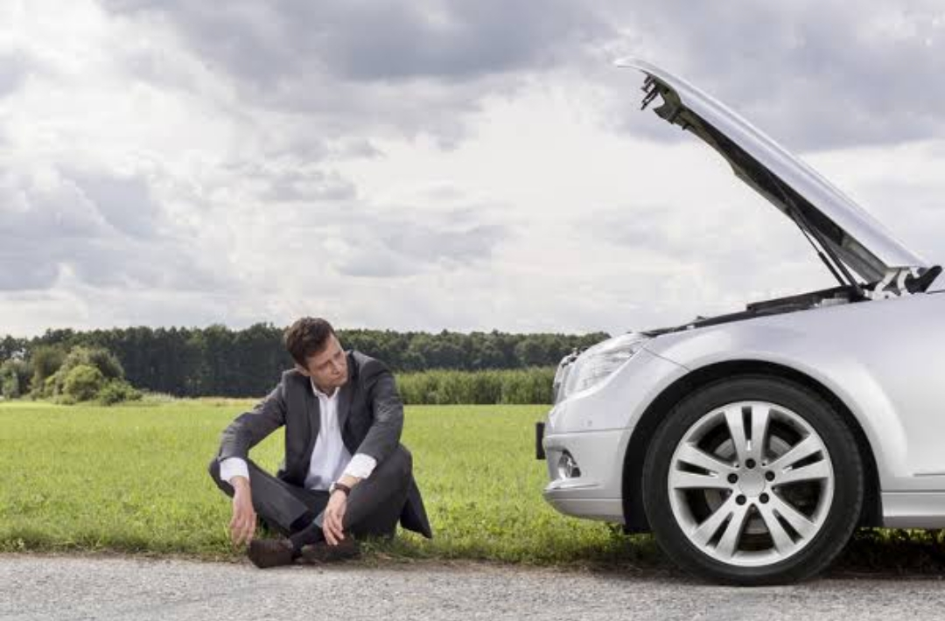
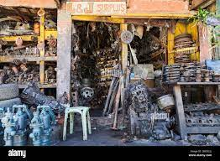
What problem our startup is solving ?
In India automobile modification & repairing sector is an unorganized sector. In Our startup SIBEY INDIA PVT LTD. we are trying to make the process of modification & repairing of vehicles easy and organized.

Slide 3

Sibey India
Organising Inordinatos

Slide 4
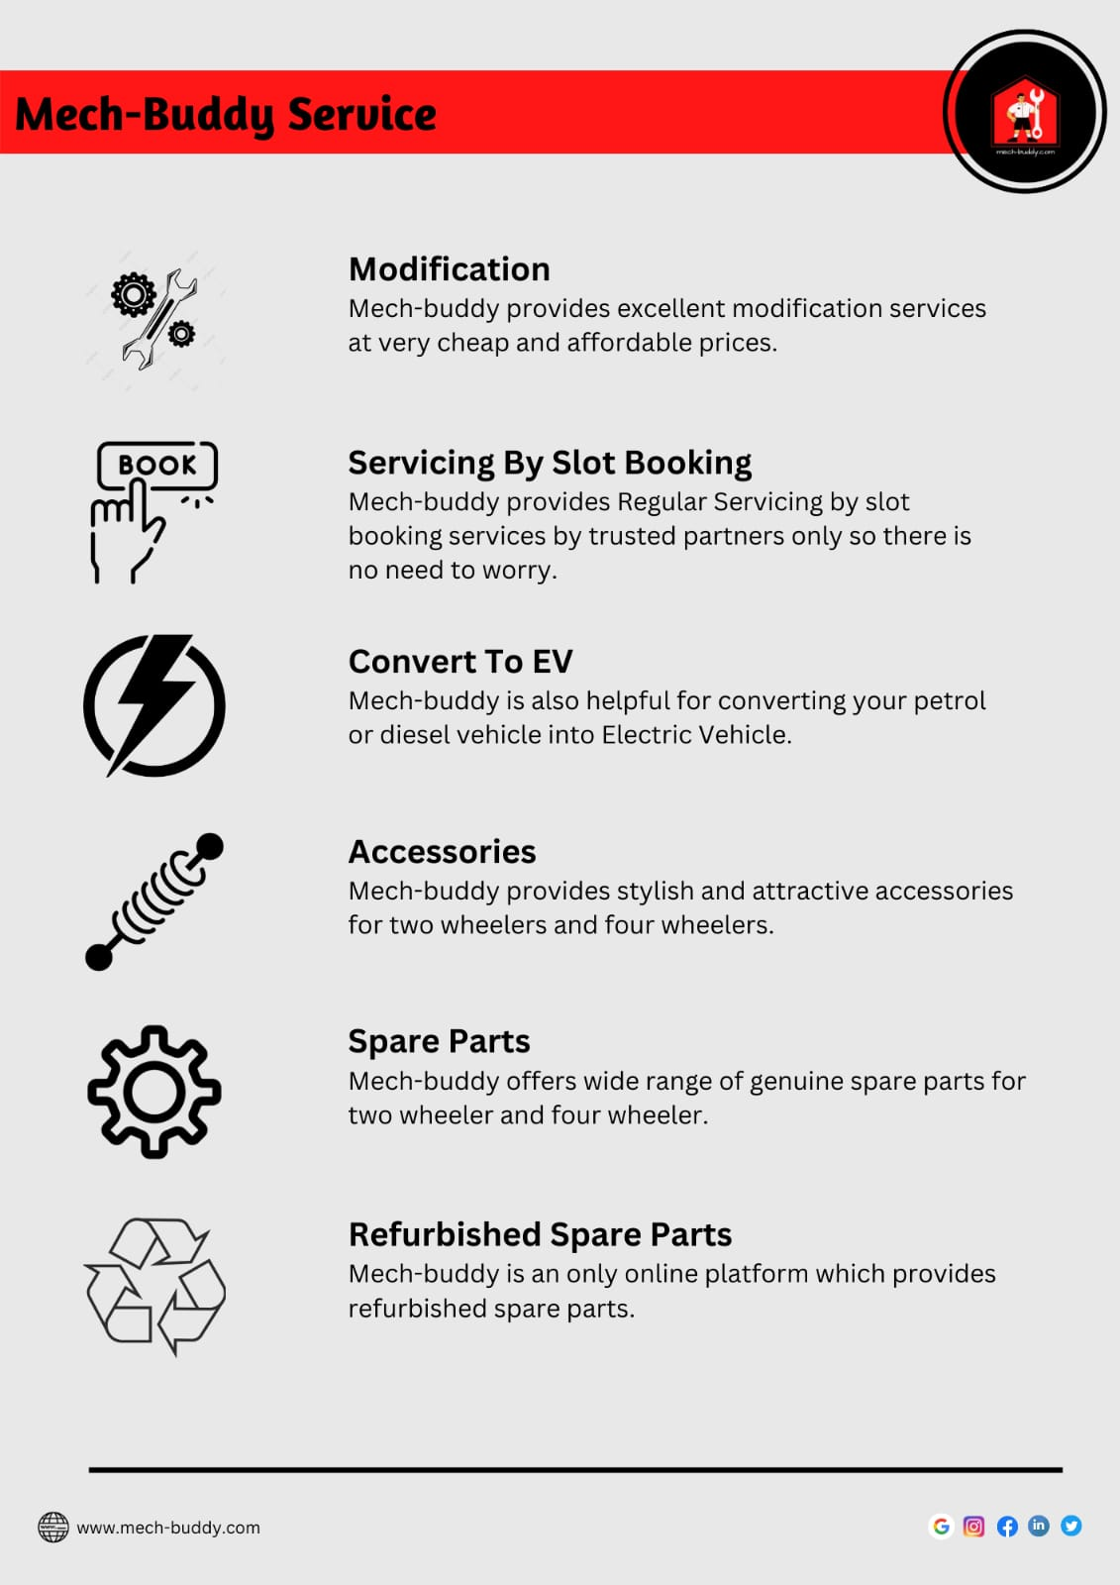
How are we solving that problem
A typical problem faced by customer is that they want to modify their vehicles but they don’t know exact cost, method, timeline etc. Here product of SIBEY INDIA PVT LTD. @mech-buddy comes handy as they instantly we solve their problem by offering genuine and quality service in a very friendly budget.
Also we have a On the spot servicing where customer can get service at their location apart from all these service’s @mech-buddy also offers spare parts, accessories & refurbished spare parts in same platform.

Slide 5

What is the USP of our solution
On the spot Servicing of Vehicles
Servicing by slot booking
Genuine vehicle modification service
Convert to EV
Refurbished spare parts
Apart from all this, the future goals of Mech-Buddy will have a wide variety of the best services. Such as R.T.O Related Services & Vehicle rental services etc .

Slide 6
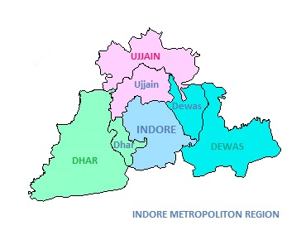
On The Spot Servicing ( Bikes )
Km | Price
0-5 km | Free
05-25km | 149/- Visit
25-50km | 249/- Visit
On The Spot Service

Slide 7

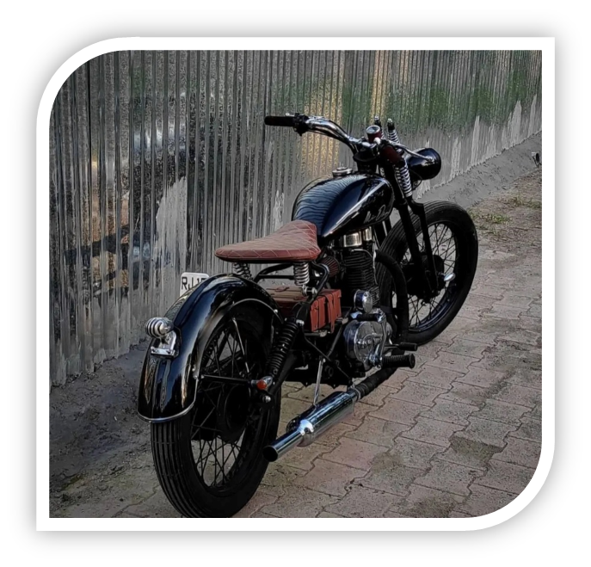
Full Body Transformation

Slide 8

Who can be our customers?
Our Target Audience is the upper class , upper middle class , middle class & lower middle class.
Specially age group b/w 18-45 year’s
Every person who uses a vehicle will be our customer.

Slide 9
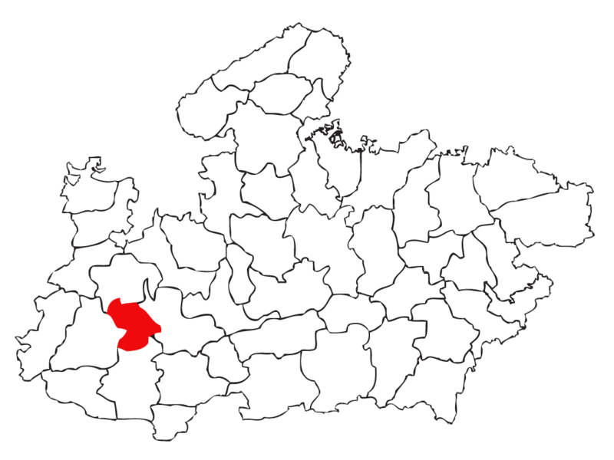

Current Status/Stage of our startup
Number of Vendor’s - 40+
INDORE , MADHYA PRADESH

Slide 10



Current Status/Stage of our startup
Approx 85% area is Covered
Indore , M.P

Slide 11
Month – September – November
Orders Completed
Revenue Generated
4+ Lakh
Total – 100+

Slide 12
How will we make money – Revenue Model?
Basic Service charges
Subscription by Customer
Subscription for Vendors
As an E-commerce
White labelling

Slide 13


Any Competition/Rivals in the market?
Speed Force
Go mechanic

Slide 14



